Slide 1
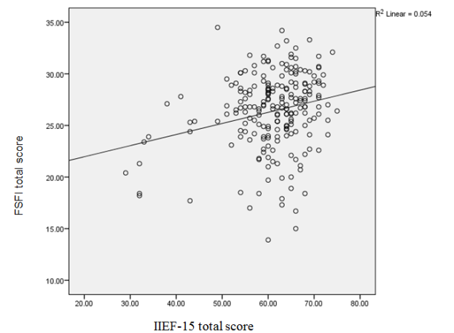
FEMALE SEXUAL DYSFUNCTION IN VIETNAMESE INFERTILE COUPLES:PREVALENCE AND CORRELATION WITH THE PARTNERS
Ho Thi Thanh Tam, Le Minh Tam, Truong Quang Vinh, Cao Ngoc Thanh
Center for Reproductive Endocrinology and Infertility (HUECREI)
Hue University of Medicine and Pharmacy, Hue, Vietnam
Paper number: 271
BACKGROUND AND AIMS
Female sexual dysfunction in infertile couples has not been investigated in Vietnam. The study aimed to assess the prevalence of female sexual dysfunction and investigate the relationship between female and male sexual dysfunction on infertile couples.
MATERIALS AND METHODS
Cross-sectional descriptive study, using designed questions including the Female Sexual Function Index (FSFI) and the International Index of Erectile Function (IIEF) and to respectively measure 213 female and 213 male partners on infertile couples who were examined from January to August 2017, at the Center for Reproductive Endocrinology & Infertility, Hue University Hospital.
RESULTS
Figure 1. Correlation between FSFI and IIEF-15
The rate of female sexual functioning was 45.1%. The female and male sexual functioning was slightly correlated (r = 0.233). IIEF total score had the slightly correlation to Female sexual arousal, orgasm, lubrication and satisfaction domains scores (r = 0.210, r = 0.188, r = 0.258 and r = 0.300 respectively). On the other hand, FSFI total score had the slightly correlation to male erection, intercourse satisfaction, orgasm and overall satisfaction domains scores (r = 0.181, r = 0.206, r = 0.165 and r = 0.268 respectively).
Table 1: Correlation between IIEF and subdomains of FSFI-15
 |  | Desire | Arousal | Lubrication | Orgasm | Satisfaction | Pain
IIEF-15 total score | Correlation Coefficient | 0.041 | 0.210** | 0.188** | 0.258** | 0.300** | 0.046
 | Sig. (2-tailed) | 0.556 | 0.002 | 0.006 | 0.000 | 0.000 | 0.503
 | n | 213 | 213 | 213 | 213 | 213 | 213
**. Correlation is significant at the 0.01 level (2-tailed).
Spearman's rho: Sexual pain domain
Pearson Correlation: remaining domains
CONCLUSION
Female sexual dysfunction is reported by approximately 2 in 5 Vietnamese infertility patients, higher than in the general population. It was found a positive correlation between female and male sexual function among infertile couples.
Table 2: Correlation between FSFI and subdomains of IIEF-15
 |  | Erection | Intercourse satisfaction | Orgasm | Desire | Overall satisfaction
FSFI total score | Pearson Correlation | 0.181** | 0.206** | 0.165* | 0.095 | 0.268**
 | Sig. (2-tailed) | 0.008 | 0.003 | 0.016 | 0.166 | 0.000
 | n | 213 | 213 | 213 | 213 | 213
**. Correlation is significant at the 0.01 level (2-tailed).
*. Correlation is significant at the 0.05 level (2-tailed).
Corresponding author: thanhtamhobs@yahoo.com

