Slide 1

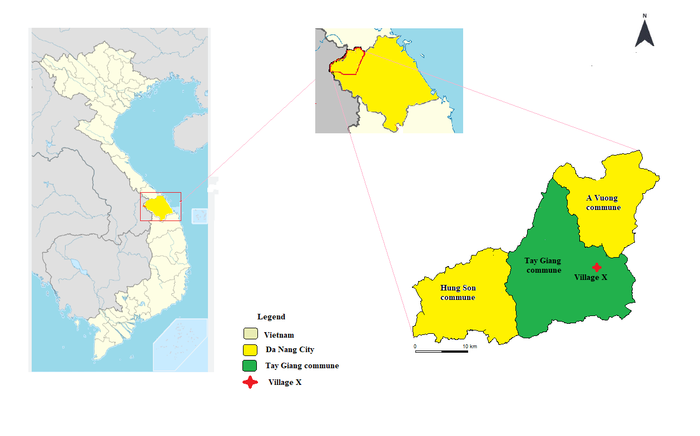
Changing Women’s Roles in Forest-Based Livelihood Activities: Evidence from a Cotu Ethnic Minority Village in Central Vietnam
Authors: Ai Thi Thu Do*,**, Ubukata Fumikazu***
*Faculty of Forestry, University of Agriculture and Forestry, Hue University. **Graduate School of Environmental, Life, Natural Science and Technology, Okayama University, Japan. ***Faculty of Environmental, Life, Natural Science and Technology, Okayama University.
Gender shapes access to forest resources and livelihood opportunities. In Vietnam, sustainable forest management programs such as Community Forest Management (CFM) and Payment for Forest Environmental Services (PFES) have changed how communities access forest resources and engage in livelihoods. However, little is known about how long-term transitions in forest governance and rural development programs have changed the livelihood pathways of Cotu men and women. This study examines how these transitions have transformed gendered livelihood roles among the Cotu ethnic minority.
BACKGROUND
METHODOLOGY
Study site: Village X is a traditional Cotu ethnic minority village located in the border region of Central Vietnam.
Sample and data collection:
Household interviews (n=20), focus group discussions (FGDs) (n=2), in-depth interviews (n=5), and participant observation.
RESULTS
Gendered participation in livelihood activities (current pattern, as of 2026 survey)
2. Transformation of gendered livelihood pathways
INSTITUTIONAL TRANSITIONS
Pre-1975-1985
Customary governance, open-access forests
1986-2007
Doi Moi reforms (1986), Forest closure
2008-2014
Settlement program, economic development, forest protection programs
2015-Present
Labor migration, stricter forest regulation
MEN
Farming, Hunting, logging, Slash-and-burn cultivation.
Farming
CFM/PFES, Wage labor, CBT, Government employment.
Farming.
CFM/PFES,Wage labor, CBT, Government employment.
Factory work.
Farming, Hunting, logging, Slash-and-burn cultivation.
WOMEN
Farming, Domestic work.
NTFP selling, Small business.
Wage labor, Rubber, Medicinal planting, CBT.
Farming, NTFP gathering, Domestic work.
Farming, Domestic work.
NTFP selling, Small business.
Farming, Domestic work.
NTFP selling, Small business.
Wage labor, Rubber, Medicinal planting, CBT.
Household management.
- Men engage in non-farm activities.
- Women remain engaged in forest- and household-based livelihoods.
Forest regulations and economic development programs reduced villagers’ autonomy while reshaping gender-differentiated livelihood pathways.
CONCLUSION

